Slide 1

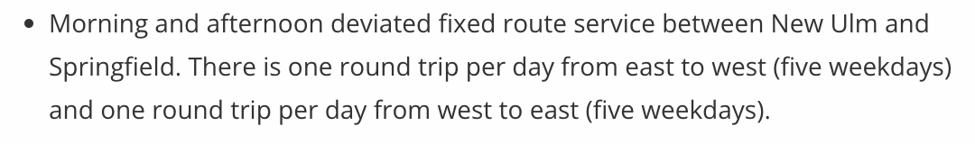
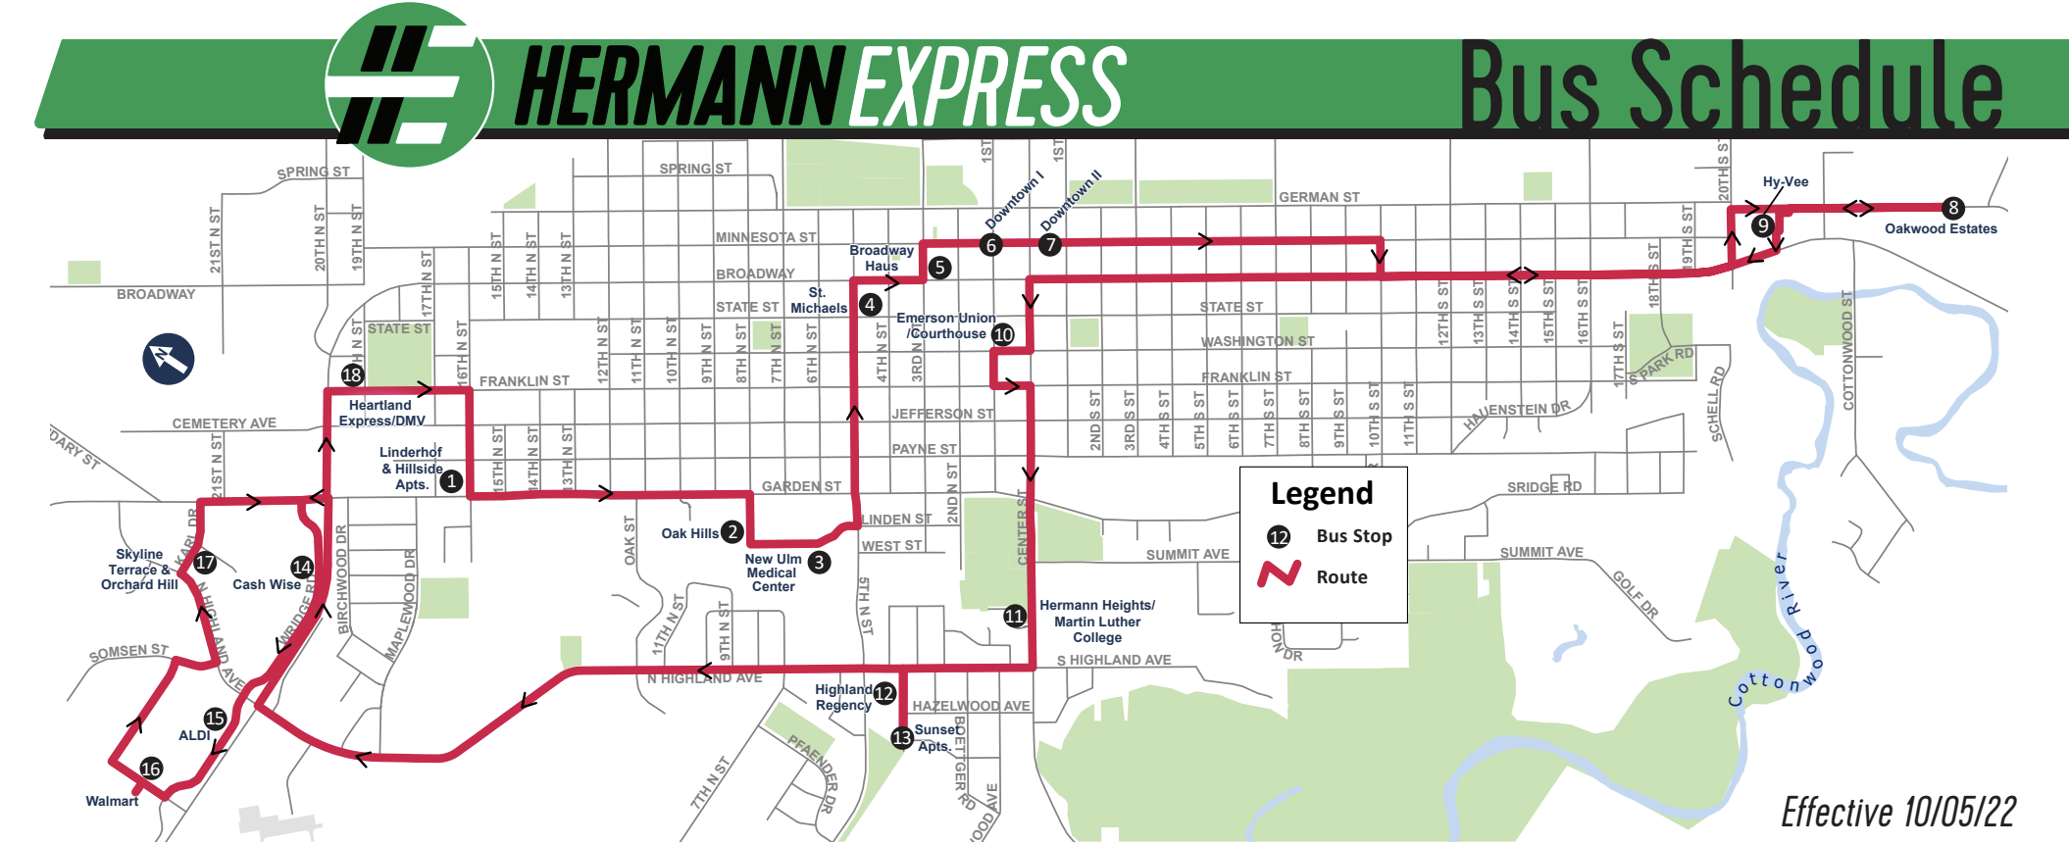
Rural Agencies with Fixed Route Service
Brown County Heartland Express:
New Ulm Hourly Fixed Route
(Route/schedule information not available in GTFS)

Slide 2
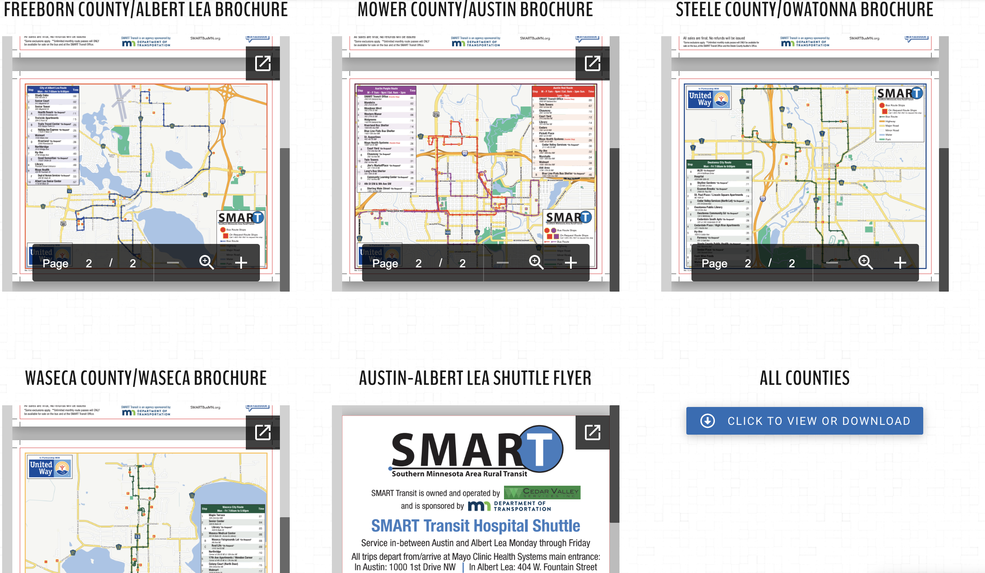
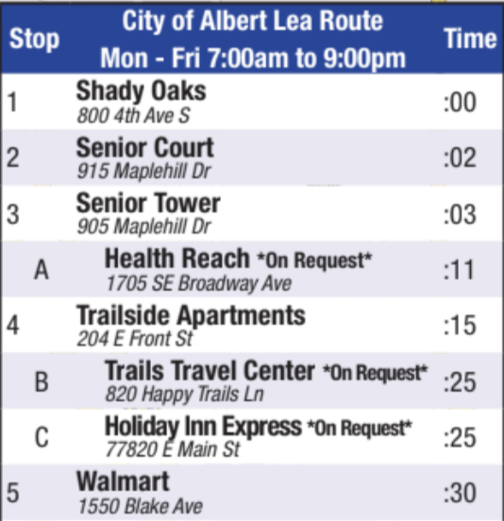
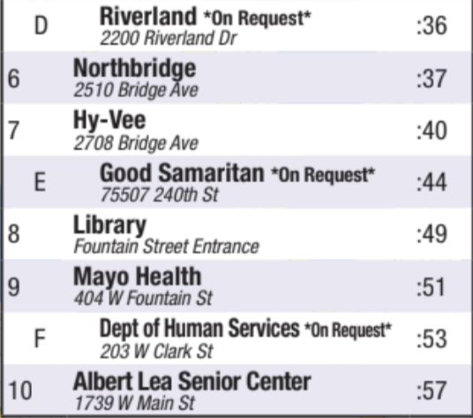
Rural Agencies with Fixed Route Service
SMART Transit- Hourly deviated fixed route services within cities/counties with 3 blocks of deviation allowed for drop-offs. Mostly aimed at giving seniors access to grocery stores, community destinations, health providers
(Route and schedule (not dynamic) available in GTFS)
Also a fixed route shuttle between Austin and Albert Lea

Slide 3
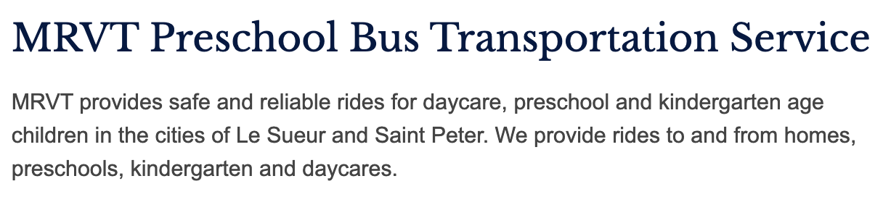
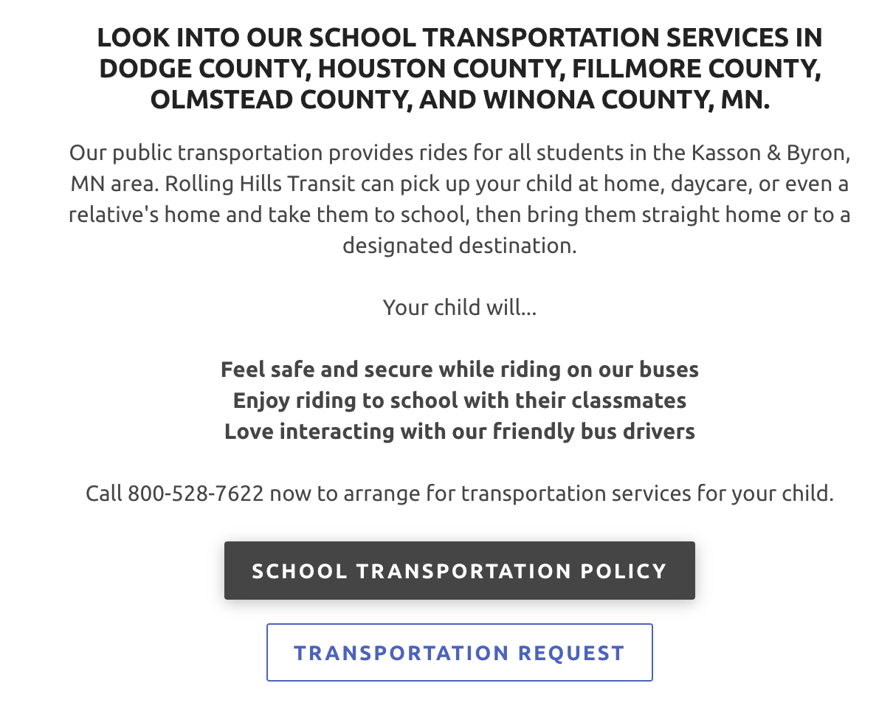
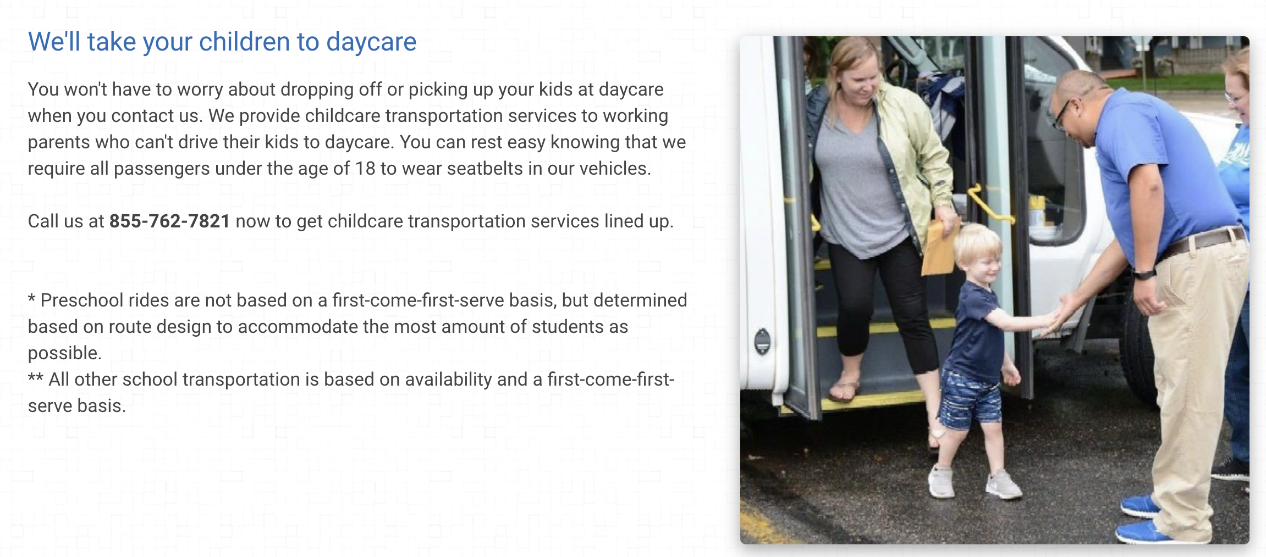
School-Oriented Bus Service – Include?
Minnesota River Valley Transit:
Rolling Hills Transit*:
SMART Transit:
*must register for service before the school year starts

Slide 4
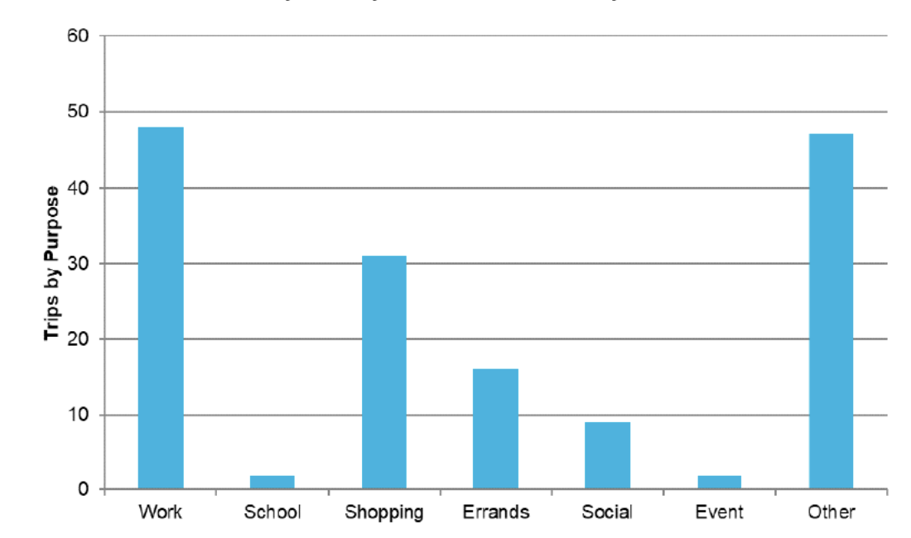
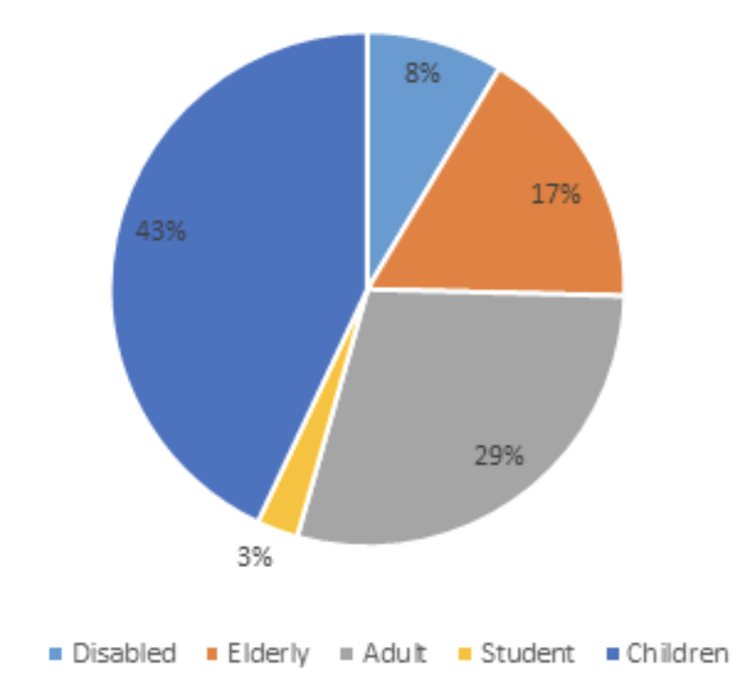
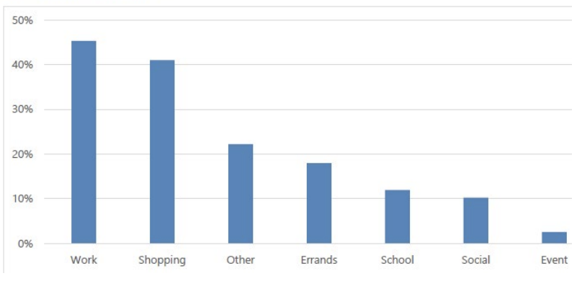
School-Oriented Bus Service – Include?
Rolling Hills Transit 2017 Ridership Breakdown:
Versus Brown County Heartland Express 2016 Trip Purposes:
Versus SMART Transit 2016 Trip Purposes:
[MPTA, 2016-2017 data, 2019 reports]

Slide 5
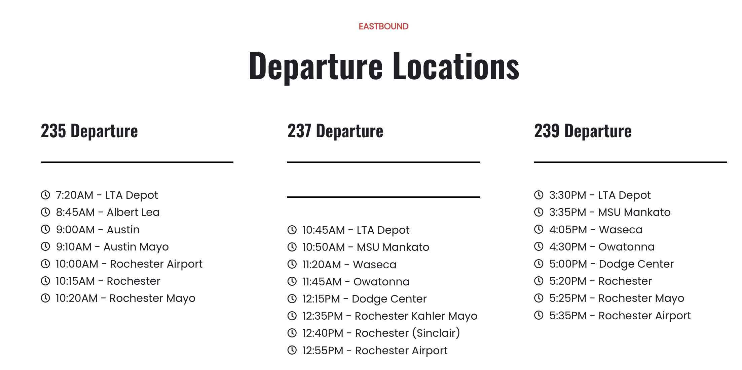
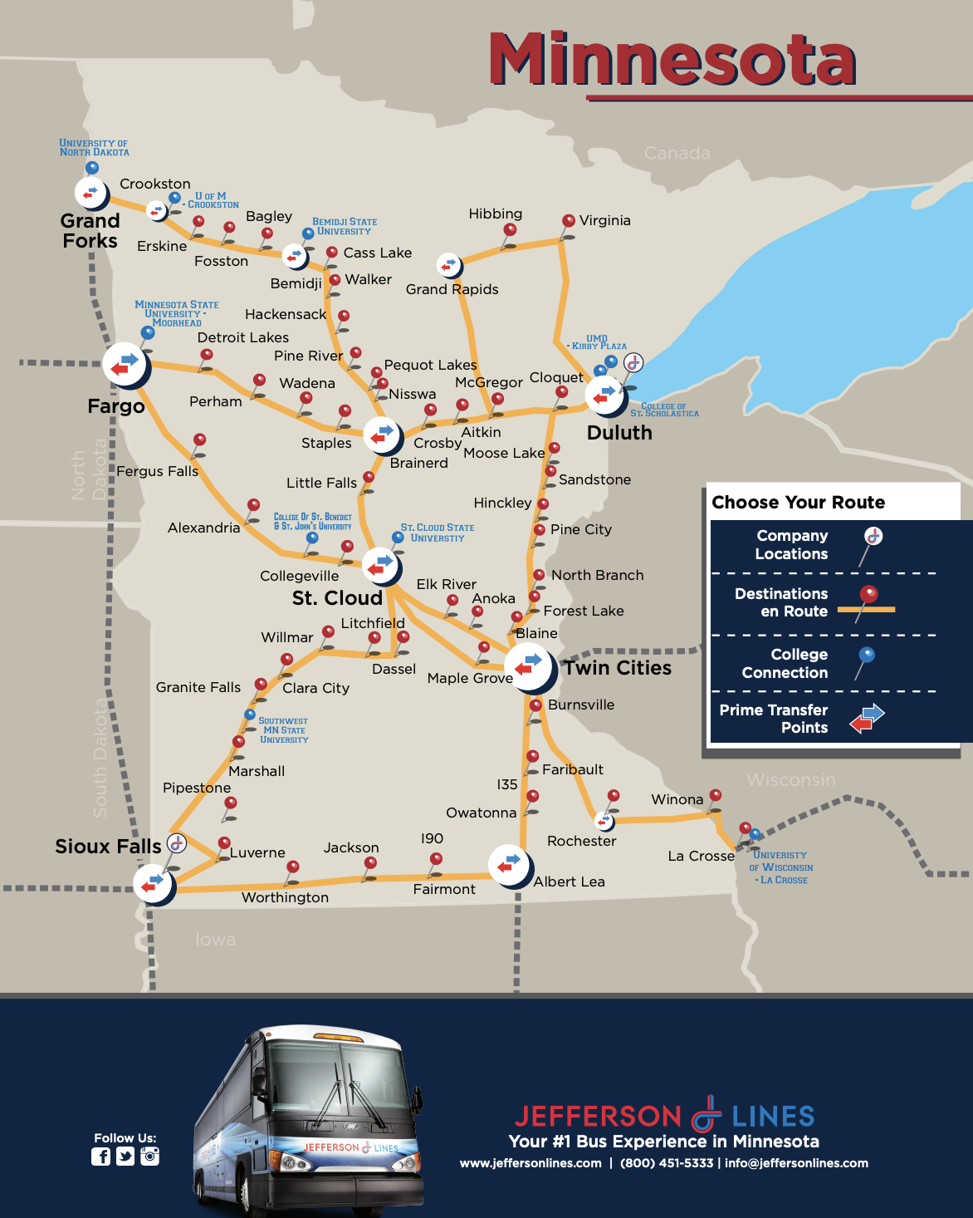
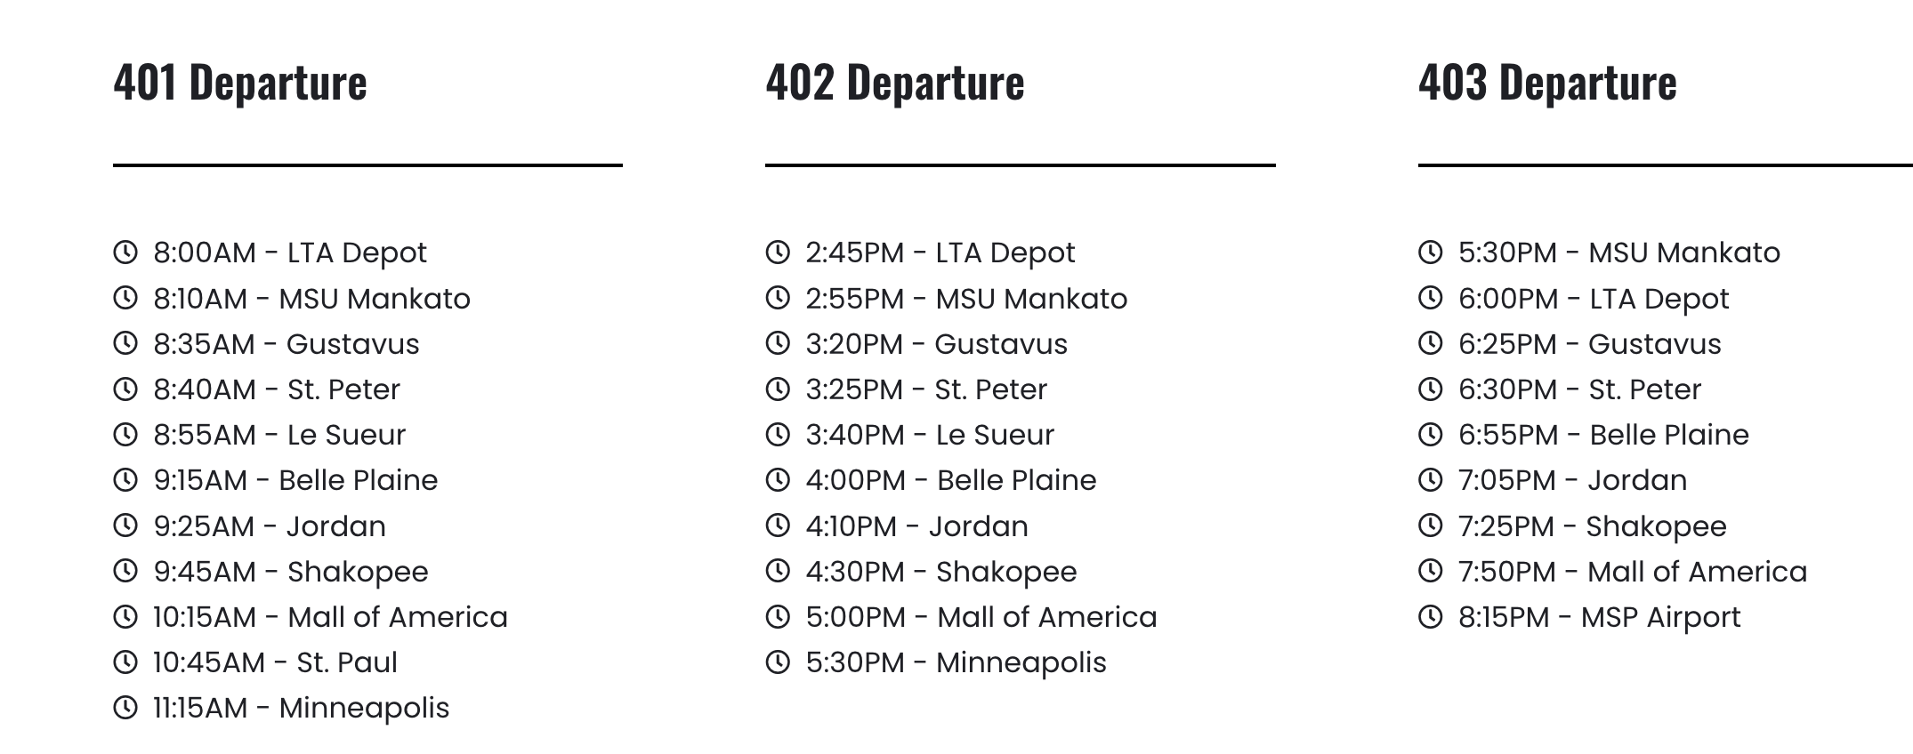
Other (Private) Intercity Routes to Consider:
LandAir Express
Jefferson Lines
Does MnDOT have access to:
Ridership data?
Pricing?
O/D trip data?
Revenue and operating cost reports
Will booking be available in transit app?
Can we get average booking time?
Notes:
What was discussed in st cloud?

